Slide 1


Natural Language Processing
with
John Hogue | January 21, 2016

Slide 2



About Me
Data Scientist at General Mills
Supporting Marketing
Founder of Social Data Science
Crowd-sourced Data Science for Nonprofits
https://www.linkedin.com/in/johnhogue
https://github.com/dreyco676
@dreyco676

Slide 3

About Me (caveats)
NLP is only a part of my job
- Code written for readability
Not optimization
- I don’t know everything ☺
- But that’s ok

Slide 4
Agenda
- What is NLP?
- Why Spark?
- What is Spark ML?
- Which algorithm to use?
- How to prepare data for ML?
- How to measure accuracy?
- Where to go from here?
Text
Classification
Example

Slide 5

What is Natural Language Processing?
http://www.dlsi.ua.es/~elloret/

Slide 6
Natural Language Processing
Studies interactions between Computers & Human Language
How would a computer summarize a book?
How does a person ask a computer a question?
How does a computer understand speech?

Slide 7

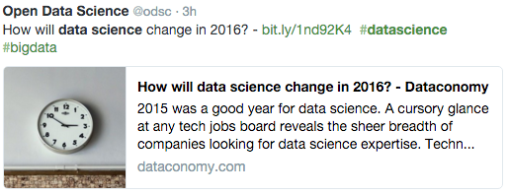
Tonight’s Example
Less of this
More of this
Notes:
Compare to Spam filtering

Slide 8
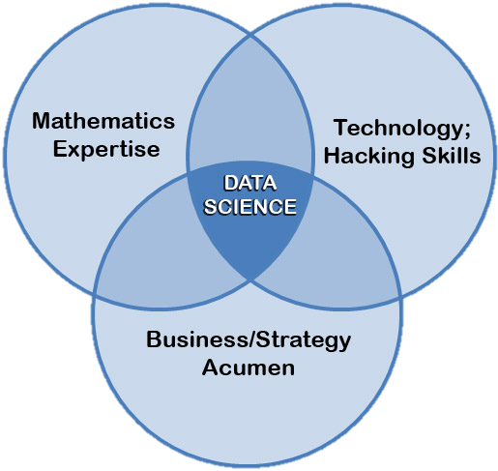

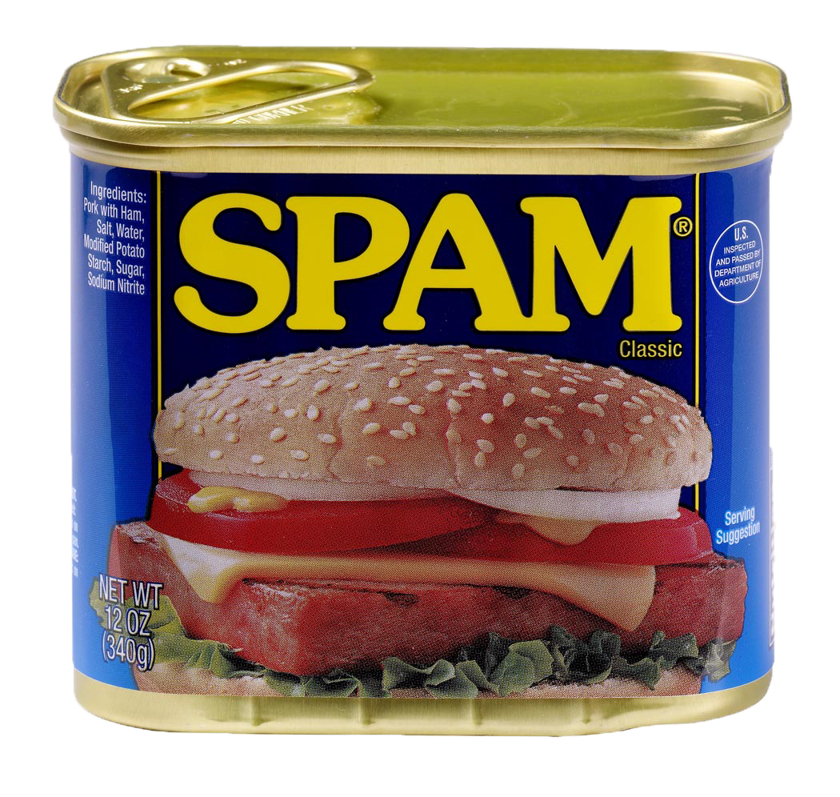
Tonight’s Text Classification Example
blah, blah, blah, blah, blah, blah, blah, blah, blah, blah, blah, blah, blah, blah, blah, blah, blah, blah, blah, blah, blah, blah, blah, blah, blah, blah, blah, blah, blah, blah, blah, blah, blah, blah, blah, blah, blah, blah, blah…
Data Science
Something else…
Notes:
Compare to Spam filtering

Slide 9

Tonight’s Data Set Corpus
Public Tweets
Everyone I follow on Twitter
149,254 Tweets Documents
Used Twython to access Twitter API
Used Hive for JSON parsing

Slide 10
Why
100x faster than MapReduce
Ideal for rapid data exploration
Great for high iteration machine learning
Code in what you know
Functional programming more suited for datasci
NLP Preprocessing ideal for parallel processing
Industry Interest
Quickly becoming a core datasci tool
Standardized ways of working with data

Slide 11

Why
Access to great libraries
NLTK
Langid
“First Class” language on Spark
Scala implementation first, Python follows
Data wrangling; less verbose is better
What’s Available in PySpark?
http://spark.apache.org/docs/latest/api/python/index.html
Replace ‘latest’ with your version Ex 1.6.0
Notes:
Talk about downsides
-horrible debugging
-some features lag
-speed

Slide 12
MLlib
MLlib Pro’s
Stable
More Algorithms Available
MLlib Con’s
Uses RDD’s
Lower Level
What’s Available in PySpark?
http://spark.apache.org/docs/latest/api/python/index.html
Replace ‘latest’ with your version Ex 1.6.0

Slide 13
ML
ML Pro’s
Abstracted to Dataframes
Easy to tune
ML Con’s
Very New, API’s change
Stability & Documentation
Few Examples
What’s Available in PySpark?
http://spark.apache.org/docs/latest/api/python/index.html
Replace ‘latest’ with your version Ex 1.6.0

Slide 14
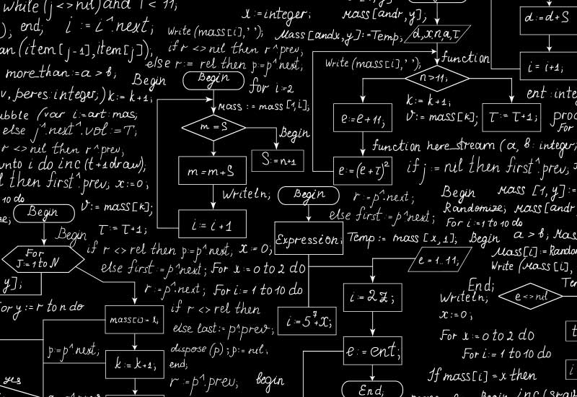
Which Algorithm?

Slide 15


Slide 16
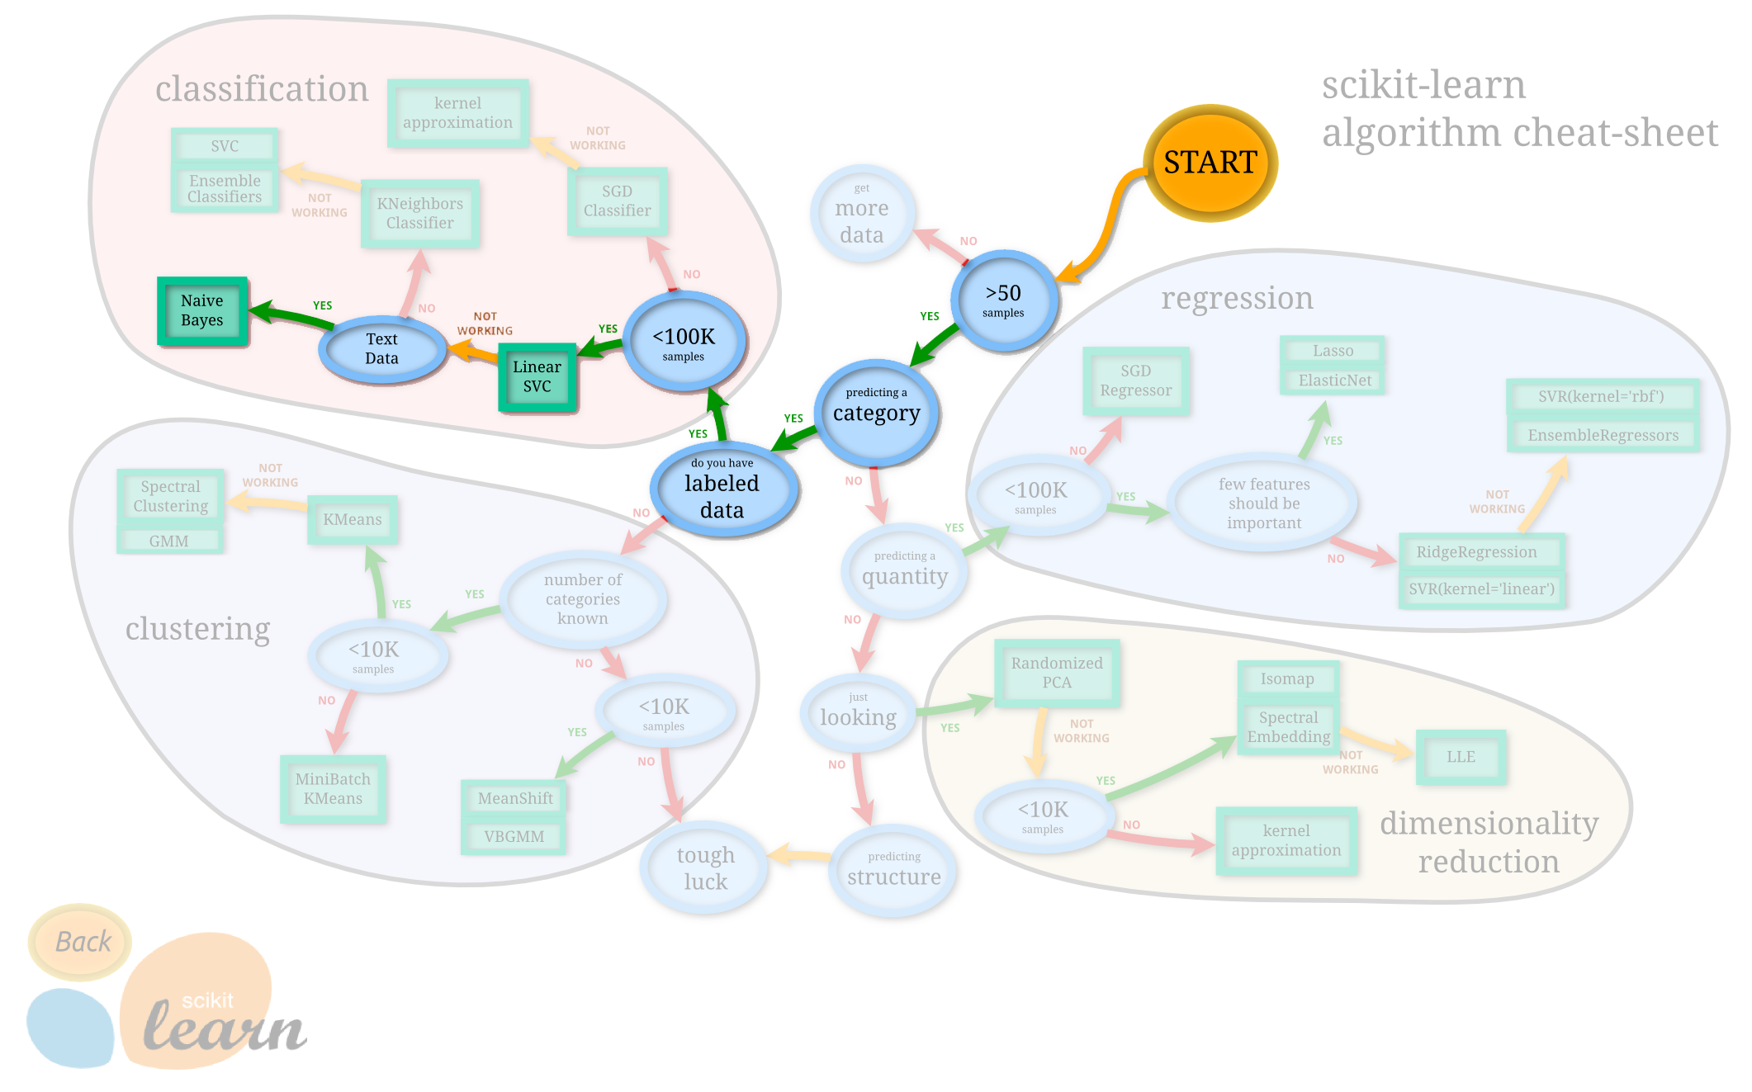

Slide 17
Naïve Bayes
This is Hadoop User Group; not math class
Detailed mechanics found here: Naive Bayes text classification - The Stanford NLP
Input
DataFrame
Id
Label
Numerical Vector
Output
DataFrame
Id
Predicted Label

Slide 18
Labeling Data
Supervised Machine Learning requires training set
Example Set
text | id | label
What's my best option for doing a MANOVA in #python ? A brief google search leaves me thinking R is the way to go. #pydata #stats | 514511437985611776 | datasci
RT @AnthonyNystrom: ML py -&gt; curated list of awesome Machine Learning frameworks, libraries and software -&gt; https://t.co/leY5PUi7Lh #python | 492887601045467137 | datasci
RT @raymondh: #python data analysis commandment: Thou shalt not access thine fields with indexing. Instead, use #pandas dataframes or nam | 464730495213768704 | datasci
Checked out https://t.co/Zj7Wry6vKh for text-to-speech in #python and it worked like a champion out of the box! | 443215773168066560 | datasci
#openscience and #python peeps: want service to share research data; looking at @figshare but want built-in ipython notebook viewing. Ideas? | 443004371425849344 | datasci

Slide 19
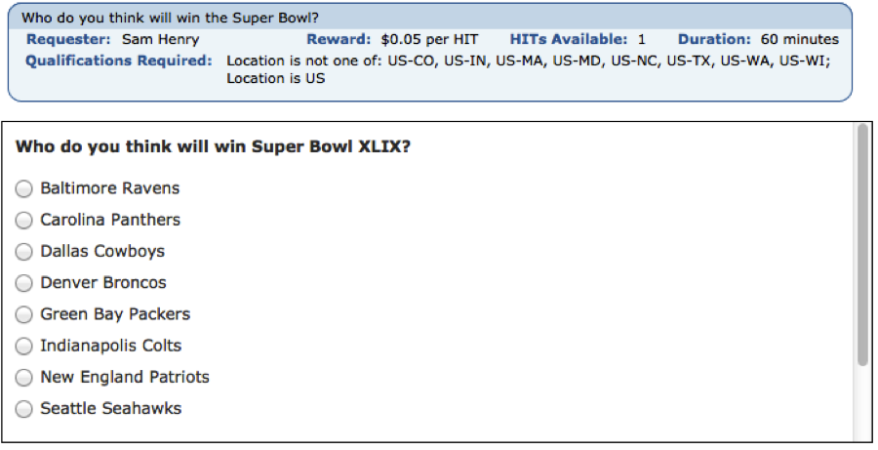

Labeling Data
Rule Based
Boolean search logic
Fast (what I did for tonight)
Biased
Manually
I got better things to do…
Biased
Crowd Sourced
Fast
Less biased
Not Free
Not acceptable for PII data

Slide 20
DataFrames
Similar to:
Table in a relational database
Python Pandas DataFrame
R data.frame
Distributed under the hood
Named and Typed Columns
No more remembering array indexes!

Slide 21
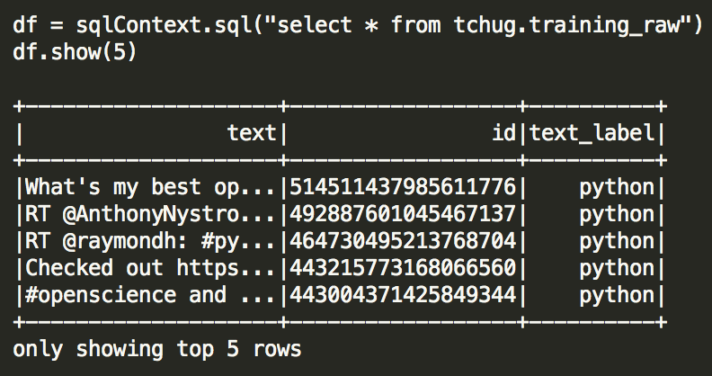
DataFrames
Creating a DataFrame from Hive is simple
Just need Hive configured correctly

Slide 22
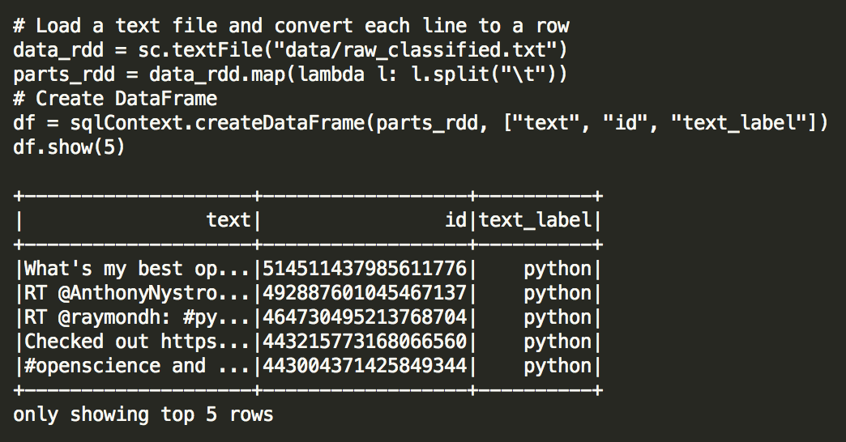
DataFrames
Creating a DataFrame from text file is a bit harder
Check out Data Bricks for a better way: https://github.com/databricks/spark-csv
This could also be a location in HDFS

Slide 23
Preprocessing Text Data
Need to simplify text into only its most important components
Humans are inefficient communicators…
Differs by application of NLP and corpus
Trial and error often are necessary
Most Preprocessing can be done in parallel!

Slide 24
Preprocessing
Natural Language Tool Kit (NLTK) http://www.nltk.org/
Amazing full fledged library
Multi-language support
Toy Datasets
Pythonic
langid https://github.com/saffsd/langid.py
Small library that classifies language of text
Pythonic

Slide 25

Managing Libraries in Hadoop
Local Python Interpreters on each node
Install shared libraries to Edge Node
Make Linux Share available to all nodes
Put all support files for the libraries in the share!

Slide 26
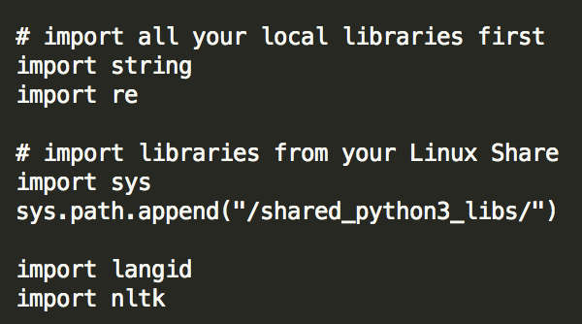
Managing Libraries in Hadoop

Slide 27
Filtering Language
A lot of the following steps are language specific
Twitter only reports the language of their Menu
Users may speak multiple languges
Clean Up
Return Language of Tweets with 90% certainty
Filter down to only English

Slide 28
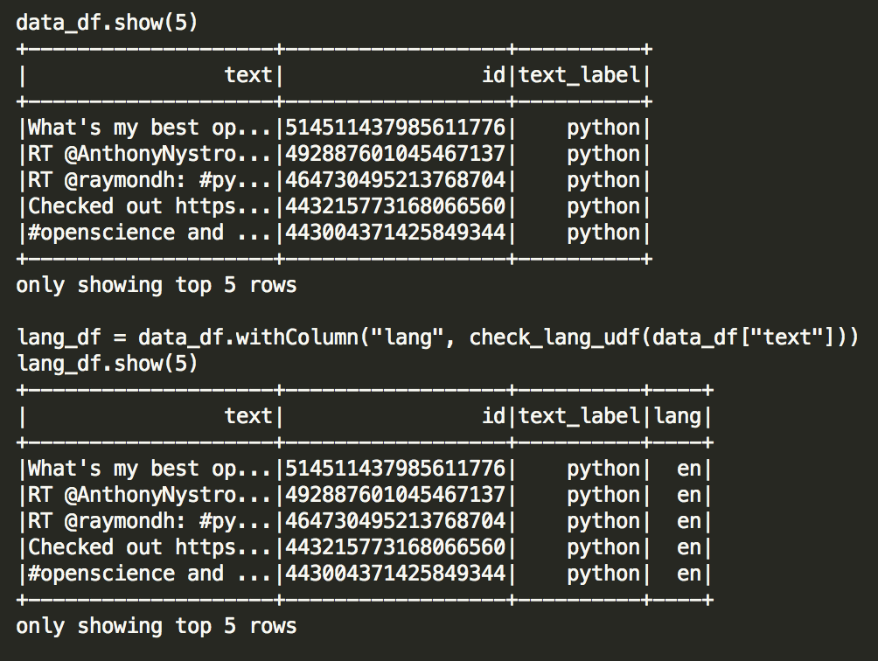
Before / After

Slide 29
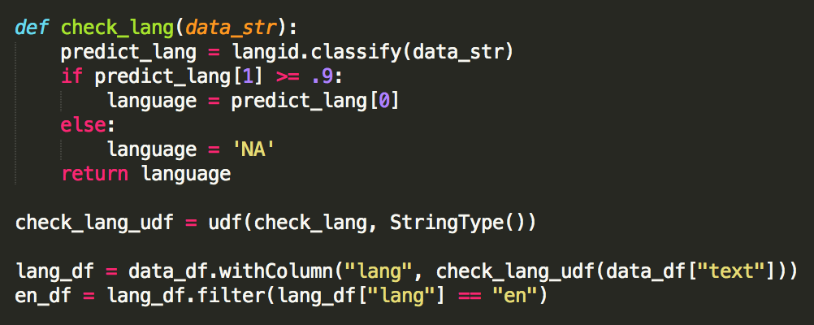
Custom Functions in
Normal Python function
Executed on a single Executor
Registering it with udf() distributes it across cluster
Requires DataType()
withColumn() creates a new column
Issues with in place operations…

Slide 30
Note about DataFrames…
Better to create a new DataFrame
WAY slower to do in place
Easier to make a changes on the fly

Slide 31
Removing Stop Words
Most common words in a language
of, and, a, the, etc
Meaningless in computation
Actually makes things faster to remove
No universal set
Plenty of good starting points in NLTK

Slide 32
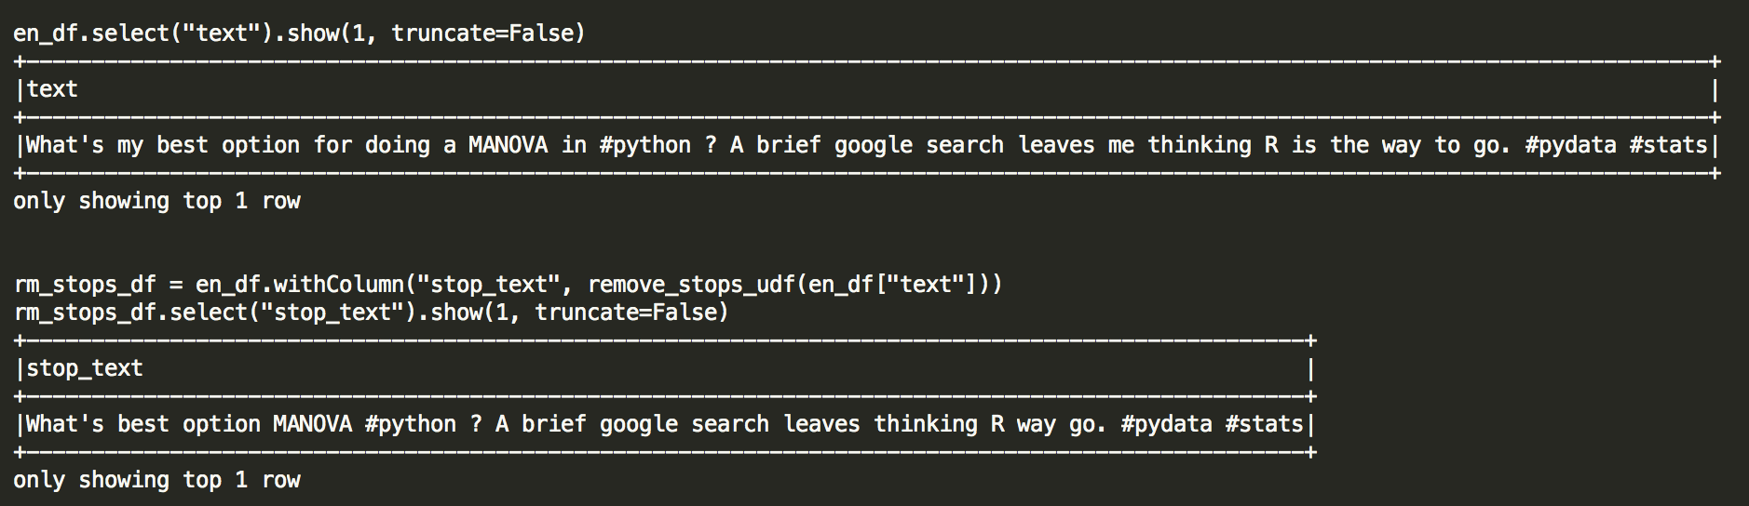
Before / After

Slide 33

Removing Misc Junk
This is where I become a ‘Data Artist’
Remove URLs
Punctuation
Numbers
@Mentions
http://www.robwass.co.uk/

Slide 34
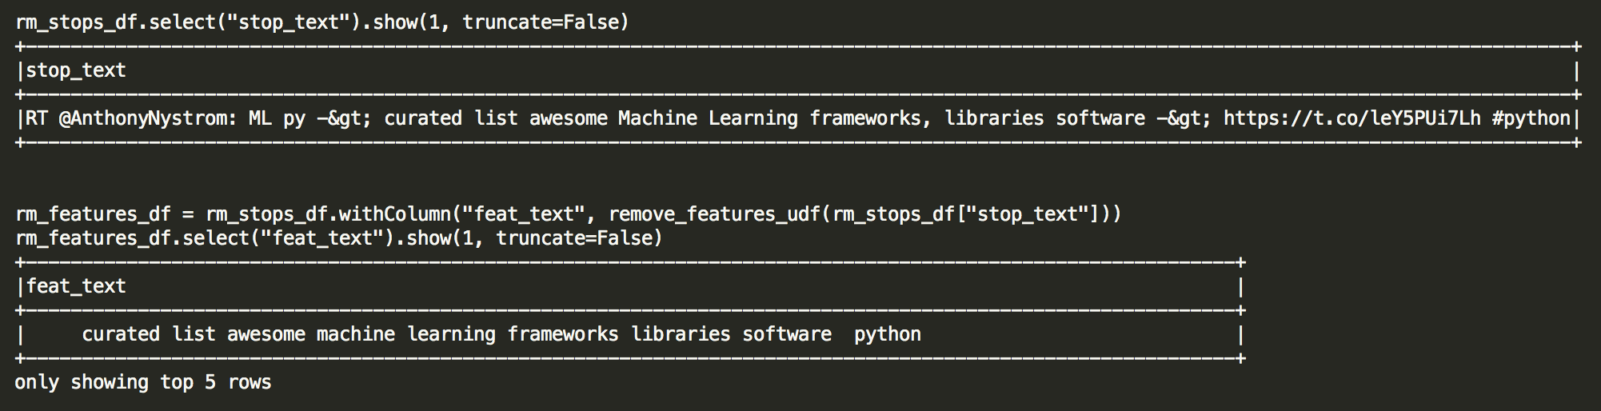
Before / After

Slide 35
Part of Speech Tagging
Keeping only the important stuff
Nouns, Adjectives, Verbs
Use NLTK to tag them
Things that couldn’t be tagged are kept
Hadoop, datascience, etc

Slide 36
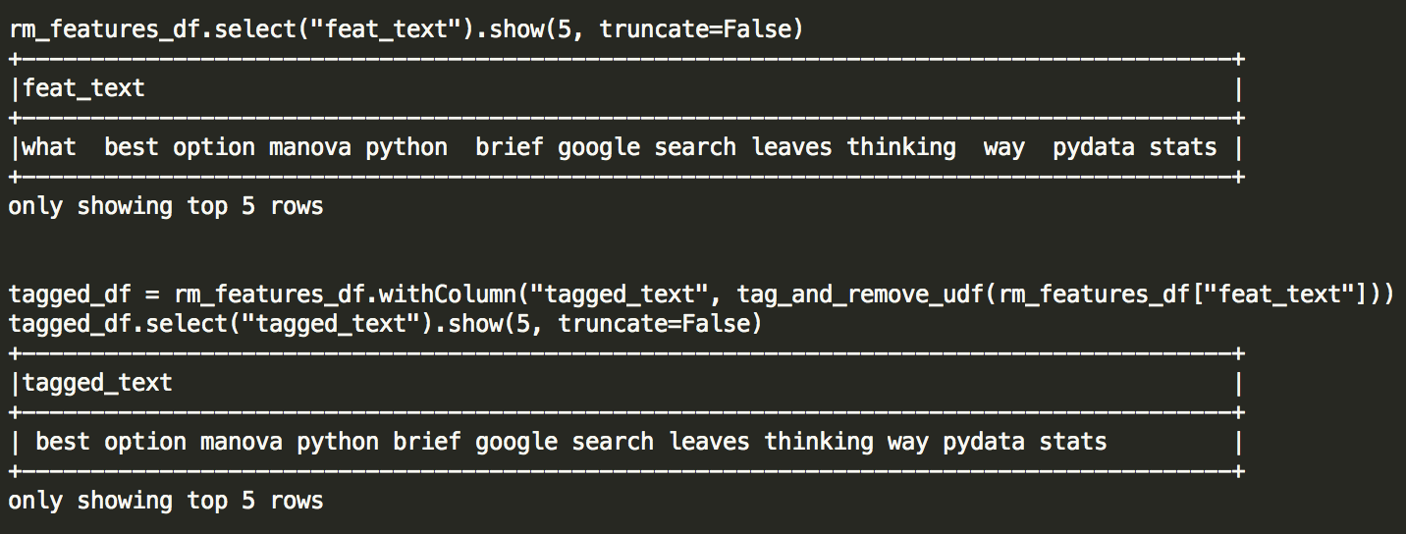
Before / After

Slide 37
Lemmatization of Words
Standardizing Words
organize, organizes, and organizing organize
Mine only removes plurals, for now… ☺
Boosts the numerical measures later on
If ’organize’ is important to a category it’s 3x higher
Another approach is to use Stemming
Less human readable

Slide 38
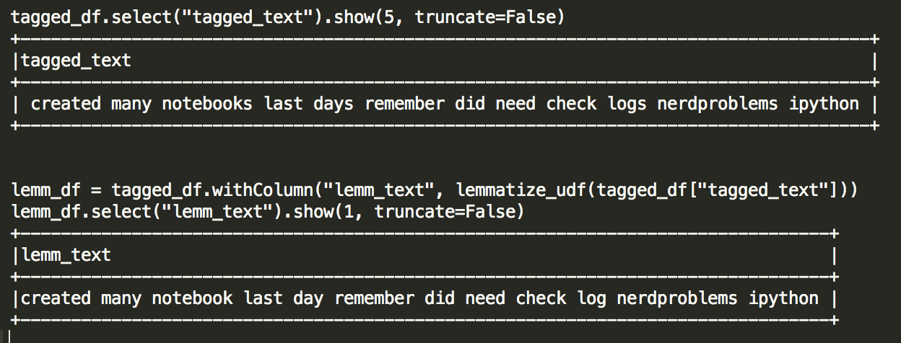
Before / After

Slide 39
Clean Up
Remove rows that have nothing left!
Deduplicate your training set
RT or @mention people identical tweets
Duplicates can adversely impact models
Split your ’cleaned’ data set randomly
Training ~60%
Test ~40%

Slide 40

It looks like you have text and not numerical data.
Would you like help?
Yes
No

Slide 41
Data Pipelining
Combine multiple steps into a single workflow
Inspired by scikit-learn
Easily tune machine learning algorithms
Consistent data format (DataFrames)
Naïve Bayes
Model
Cleaned Text
Words
Feature Vector
(id, label, text)
(id, label, text, words)
(id, label, text, words, features)

Slide 42
Tokenizing
Split a tweet into a list of words
Usually done on whitespace (tabs, space, return)
“awesome talk at TCHUG”
[awesome, talk, at, TCHUG]

Slide 43
Term Frequency Hashing
Count the number of times a word appears in a tweet
Typically also maps a given word to a number
Good example of high TF
Python, Hadoop, Spark, Pandas, etc
Bad example of high TF
Of, and, a, the, etc

Slide 44
Term Frequency Hashing
[Hadoop, is, great, python, is, great]
[(Hadoop, 1), (is, 2), (great, 2), (python, 1)]
[(12342, 1), (3423, 2), (5676, 2), (6768, 1)]

Slide 45
Inverse Document Frequency
Calculates the uniqueness of a term across tweets
Good example of high IDF
Author names, white paper titles, etc
Bad example of high IDF
Typos: pythong, datrscience, etc
Good walk through here: http://www.tfidf.com/

Slide 46
Data Pipelining
Naïve Bayes
Model
Cleaned Text
Words
Feature Vector
Tokenizer
HashingTF, IDF
Naïve Bayes

Slide 47
Building the Model
Most of the work was upfront!
8 lines of code build the model
Cross Validation is important
Pipelines makes it easy

Slide 48
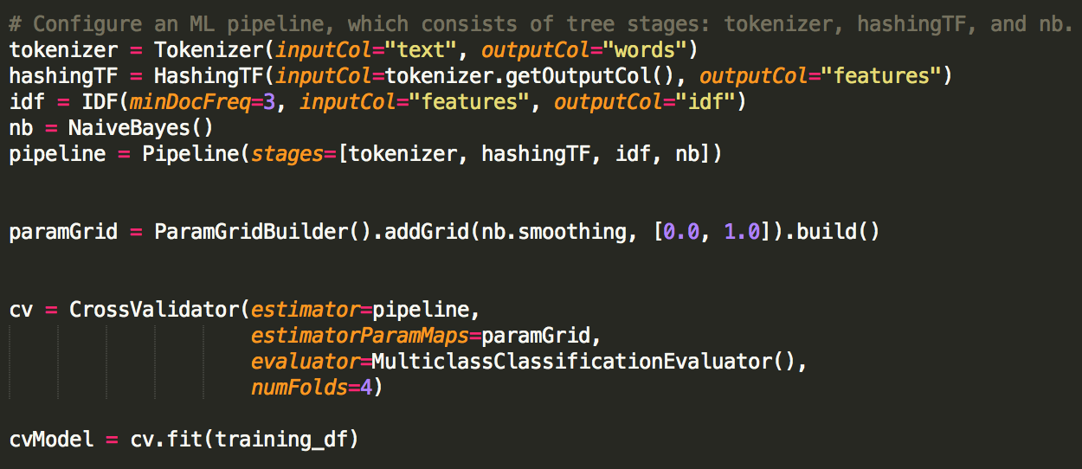
Building the Model

Slide 49
Data Pipelining
Cleaned Text
Words
Feature Vector
Predictions
Tokenizer
HashingTF, IDF
Naïve Bayes Model

Slide 50
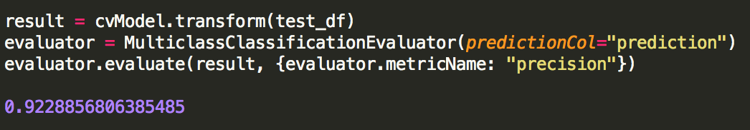
Evaluating
Use test data to verify
Once again ML Pipelines makes it easy

Slide 51
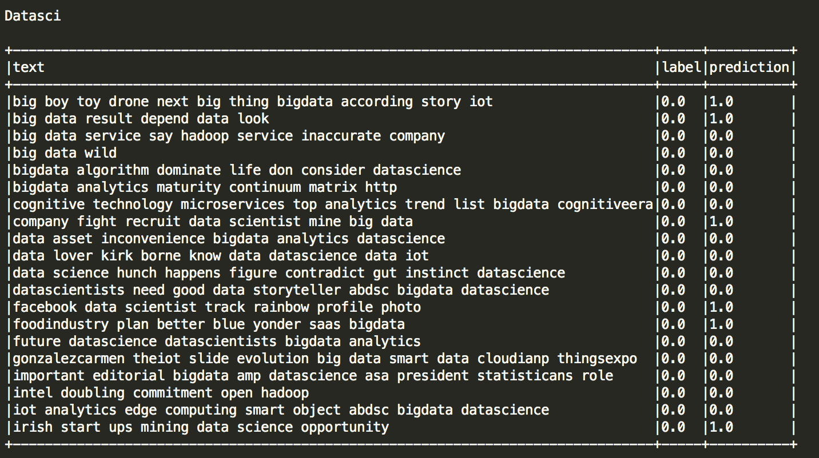
Look at Results

Slide 52
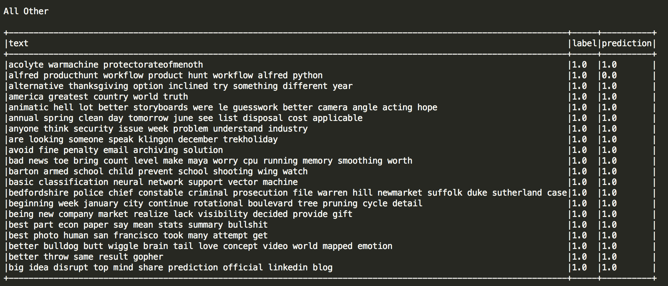
Look at Results

Slide 53
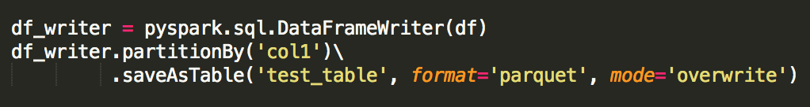
Saving Data & Model
Saving the Data with Predictions to Hive
Untested (my cluster is on Spark 1.3.0)
Saving the Model is still hard
Currently work in progress: SPARK-6725
Workaround is to serialize object to disk
Nontransferable between Spark Versions

Slide 54
Where to go from here?
Build a Twitter bot!
Retweet only Data Science Posts
Apply feedback of favorites and retweets to the model
Apply to a different application
Classify your support tickets, etc

Slide 55
Where to go from here?
Give it a try yourself! https://github.com/dreyco676/nlp_spark
Need Spark 1.6 Installed
Need Anaconda 2.4.1 (Python 3.4)
NLTK & NLTK Data
Langid
Happy to answer questions & issues

